Slide 1
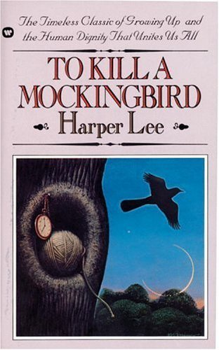
To Kill a Mockingbird Background Notes

Slide 2
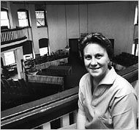
Harper Lee
Was born in Monroeville, Alabama on 04/28/1926.
Childhood best friend was Truman Capote, who came to Monroeville during the summers to stay with his aunt. Mr. Capote also became an author.
Her father served in the State
Legislature from 1926 to 1938.
Attended Huntington College
and the University of Alabama.
Though Harper Lee denies that
this novel is autobiographical,
the parallels are obvious.

Slide 3
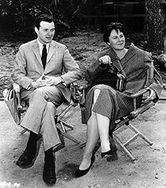
Harper Lee
Submitted the manuscript for To Kill a Mockingbird in 1957, and then spend 2½ years editing before its publication in 1960.
The novel was an instant success,
and won the Pulitzer Prize for fiction.
It is estimated that there are
30 million copies in print.
The novel was turned into a
movie in 1962, and the now
deceased Gregory Peck won
an Oscar for the film.

Slide 4
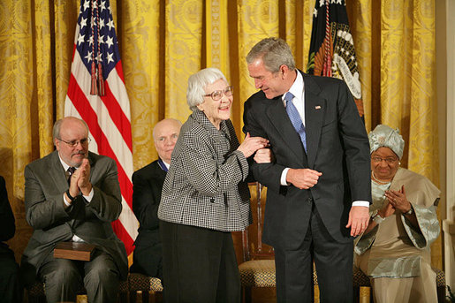
Harper Lee
Harper Lee has only published two novels: TKAM in 1960 and Go Set a Watchman in 2015 .
She was very elusive, did not make public appearances, and did not participate in interviews. She died in 2016.
This picture is from
when she received the
Presidential Medal
of Freedom in 2007.

Slide 5
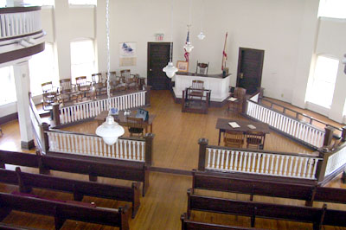
Setting of the Novel
To Kill a Mockingbird is set in Maycomb, Alabama, which is an imaginary town. However, Monroeville, Alabama, is a real town, and you can visit a replica of the courthouse there.
Maycomb is a relatively
rural area, and it’s
isolated. Many of the
citizens are poor
farmers or manual workers.
Newcomers are rare.

Slide 6
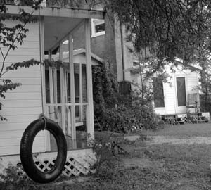
Setting of the Novel
The story begins in the summer of 1933 and ends on Halloween night in 1935.
At this time, the country was in the middle of the Great Depression.
African-Americans and Caucasians were still segregated in the 1930’s.

Slide 7
Historical Background
Remember: Though To Kill a Mockingbird is set in the 1930’s, it was written in the 1950’s – a time of great racial tension in America.
1954 – Brown vs. Board of Education states that “separate but equal” was unconstitutional, and schools must be integrated.
1955 – Rosa Parks is arrested for refusing to give her seat on a bus to a white person.
1955 – Emmett Till, a 14-year-old boy, is beaten, shot, and lynched in Mississippi for whistling at a white woman.

Slide 8
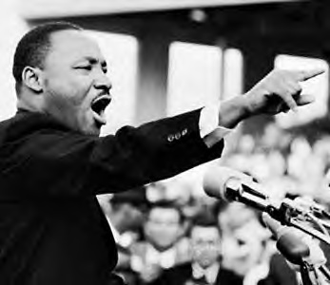
Historical Background
1956 – Martin Luther King’s
home is bombed.
1957 – Nine black students attempt to enter an all-white high school in Little Rock, Arkansas, and had to be protected from white mobs by Federal troops.
1960 – To Kill a Mockingbird is published.
1962 – To Kill a Mockingbird movie is released.

Slide 9
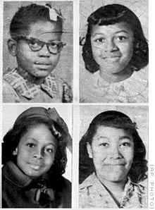
Historical Background
1963 – Martin Luther King delivers the
“I Have a Dream” speech in Washington, D.C.
1963 – Four black girls are killed at Sunday School when a Birmingham church is bombed.
1964 – The Civil Rights Act
is passed.

Slide 10
Jim Crow Laws
“Jim Crow” was the name of a racial caste system that existed in the Southern United States between 1877 and the mid 1960’s.
The system suggested that Caucasians were superior to African-Americans in all ways, including intelligence, morality, and civilized behavior.
People believed that blacks and whites should be separated and not have sexual relations because a “mixed” race would destroy America.

Slide 11
Some examples of Jim Crow Laws:
A black male could not shake hands with a white male because it implied social equality.
Blacks and whites could not eat together.
White motorists had the right of way at all times.
A black person could not even suggest that a white person was lying.
Schools were separate. As were restaurants, water fountains, restrooms, and even parks.
Cruel justice, such as lynching, was “necessary” because blacks were thought to be prone to violence.

Slide 12
Jim Crow Laws
In essence, the Jim Crow caste system was this:
1. White females
2. White males
3. “White trash” (poor, uneducated white people)
4. Black people
When slavery existed, even poor white people were
superior to black people. However, as you will see in
To Kill a Mockingbird, after slavery ended the poor white
people had to compete socially and economically with the
black people, and hatred increased.

Slide 13
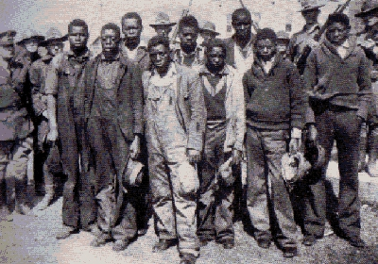
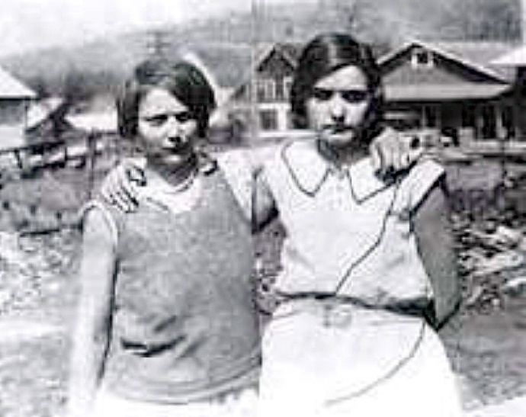
Scottsboro Boys Trial
On March 25, 1931, a freight train was stopped in Paint Rock, Alabama.
Nine African American male teenagers were riding on the train, as were two Caucasian young women.
The white girls, who were known prostitutes, accused the black boys of rape.

Slide 14
Scottsboro Boys Trial
There were no physical injuries, and the girls were not seen by doctors.
However, with no evidence, all nine boys were convicted by an all-white jury.
Later, one of the girls (Ruby Bates) recanted her story about the rapes…admitting the story was all false.
Harper Lee had been studying this court case when she wrote To Kill a Mockingbird.

