Slide 1
The Judgment of Paris
Greece and Troy Go To War

Slide 2
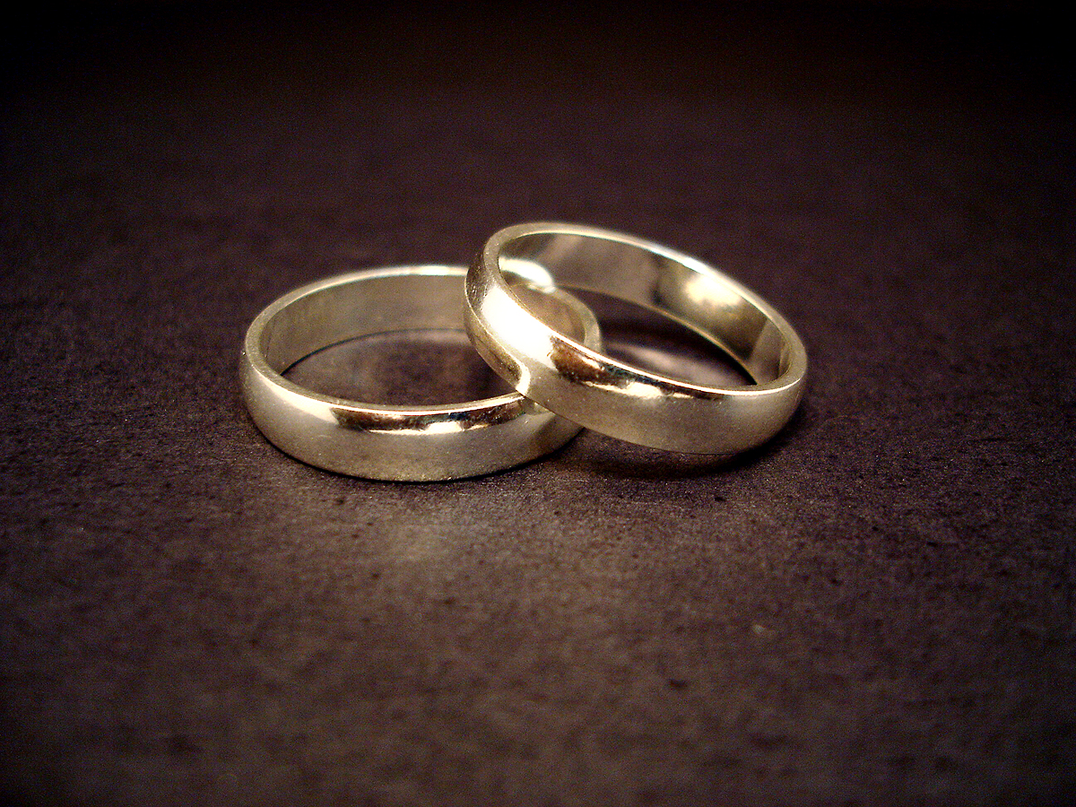
The Wedding
Many, many years ago, the sea-nymph, Thetis, married the human Peleus. All of the gods and goddesses were invited to the wedding…all, that is, except the goddess of discord, Eris.

Slide 3
Eris was pretty mad about the snub.
She came up with a plan to get
her revenge that would, of
course, cause strife and discord.
And it all starts with an apple…

Slide 4
The Plan
Eris created a golden apple, marked “For the Fairest,” and left it on a table at the wedding feast, knowing that it would be found and that all of the goddesses would fight to win the apple and the title. (Aren’t girl fights the worst? I guess they were back then, too!)
The contest came down to a contest between Aphrodite (goddess of ____), Athena (goddess of _____), and Hera (goddess of _____).
And they asked Zeus to judge and determine a winner.

Slide 5
Paris
Zeus was no dummy. He refused to judge his daughters and wife, and, instead, insisted that a human male – one who was known to appreciate female beauty – should judge them. He chose Paris.
Paris was a prince of a place called Troy. He was the youngest son of King Priam of Troy, and he liked to party a lot instead of learning to be good warrior, like all good princes of his time should be.
As you can imagine, Paris was quite happy to be asked to decide which of the three was the most beautiful goddess!

Slide 6
The Bribes
The goddesses were not dumb, either. They knew their competition were all beautiful, too, so they each came up with ways to try to bribe Paris with gifts.

Slide 7
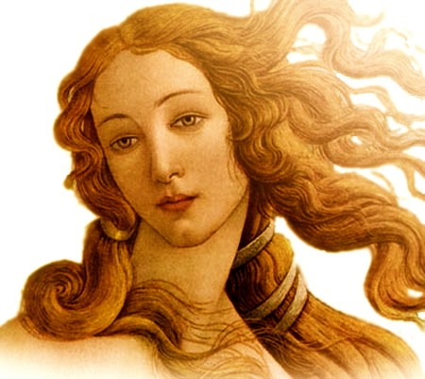
Aphrodite
Aphrodite promised Paris that
he could marry the most beautiful
woman (not goddess,
but human) in the world.
Paris liked women.
A lot.

Slide 8
Athena
Athena offered Paris the opportunity to be successful in war. Warriors were revered as heroes during Paris’ lifetime. This option would appeal to Paris because he would get all of the glory without having to even work hard.
Paris doesn’t like to work.
He likes to play.

Slide 9
Hera
Hera didn’t have a lot to be happy about, with Zeus as her husband, but she was the most powerful goddess as a result of her marriage. She understood the value of power, so she offered Paris the chance to become the most
powerful man in the world.
Seriously! He didn’t have to settle
for being a mere hero – he could be more
powerful than any king, anywhere!

Slide 10
The Result
No surprise here: Paris gave the golden apple to Aphrodite.
In return, Aphrodite took him to the Greek Island, Sparta, where the most beautiful woman in the world, Helen, lived with her husband, Menelaus.
Remember that the goddess, Eris, wants to cause discord? She is successful…
Paris kidnaps Helen, takes her across the sea to Troy, and marries her. His rash actions lead to the 10-year-long Trojan War, (fought between the Greeks and the Trojans) and, ultimately, to Paris’ death and the destruction of his empire.

Slide 11
Paris is a Dummy. And Aphrodite is a Mean Girl.
OK. Paris kidnapping another man’s wife is bad, no matter how you spin it. The story gets even worse when you consider the following:
The man Paris stole Helen from was not just any man.
He was Menelaus - a king…the king of SPARTA…and the Spartans are known to this day as the fiercest, strongest warriors in history. True story: The Spartans removed seven year-old boys from their homes and sent them to “warrior schools,” where they lived and learned how to engage in battle. They were treated harshly in order to toughen them up, and they were not allowed to return home to their mothers. Not even on their birthdays. They lived in these schools until they either died, or brought honor to themselves and their city in battle as adults.
Sparta is part of Greece.
The Grecian army is BIG and STRONG.
The entire Grecian army joined Menelaus on his quest to get Helen back.

